Slide 1
Web Crawling – JP News
0856706 Susan Ku

Slide 2

Fixed codes for Japanese news (step-by-step)
UnicodeDecodeError: 'cp950' codec can't decode byte 0xe3 in position 0: illegal multibyte sequence
KeyError: 'You need to specify `systemDict` in the config when `sudachidict_core` is not installed.’
- pip install sudachipy sudachidict_core
OSError: symbolic link privilege not held (specific error for Windows system)
- Restart Spider with administrator’s privilege

Slide 3
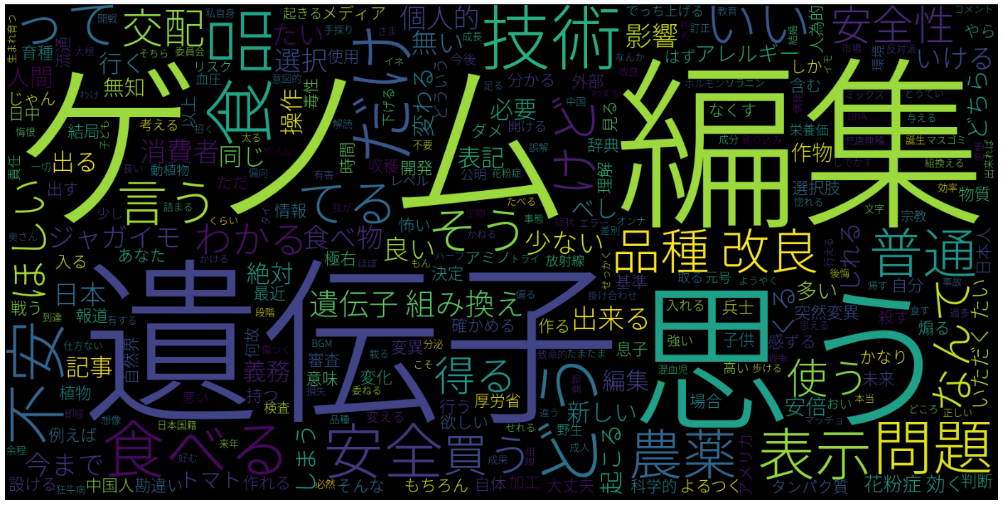
Result

